Slide 1

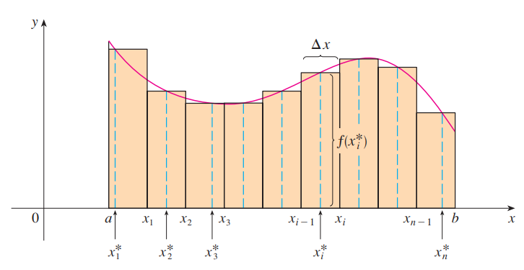

Slide 2

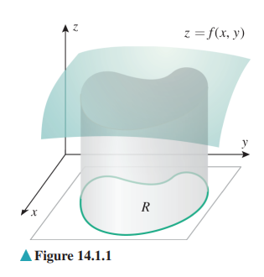

Slide 3

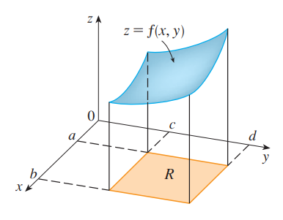

Slide 4
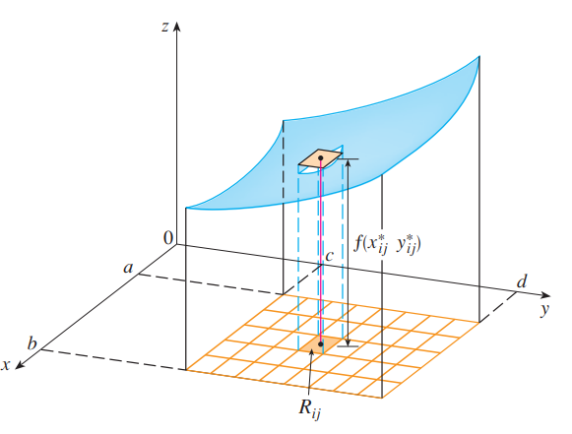


Slide 5



Slide 6

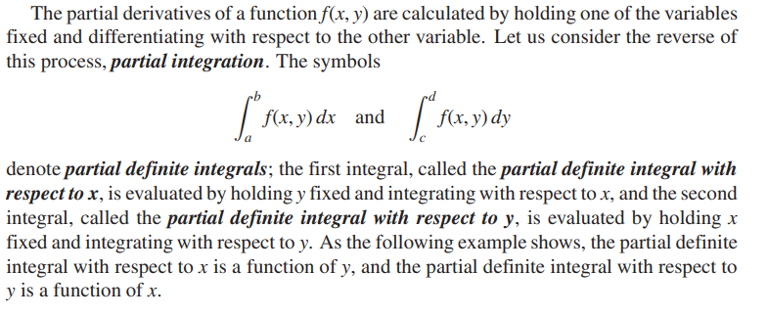

Slide 7


Slide 8
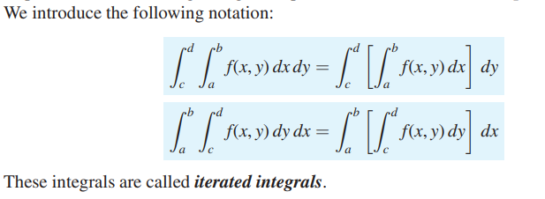

Slide 9
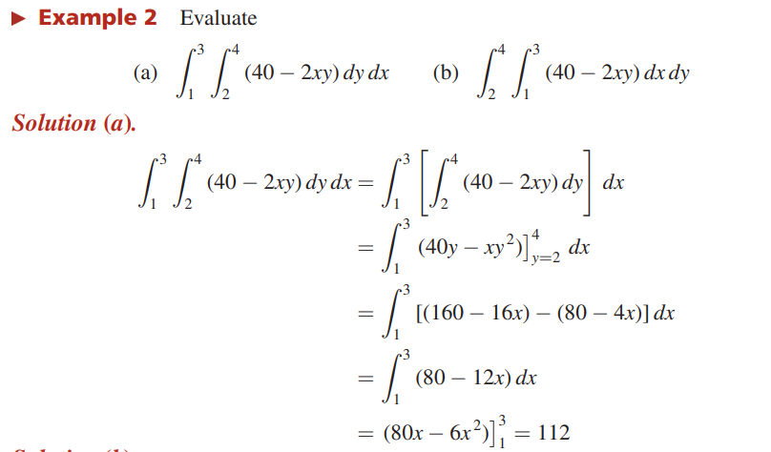

Slide 10
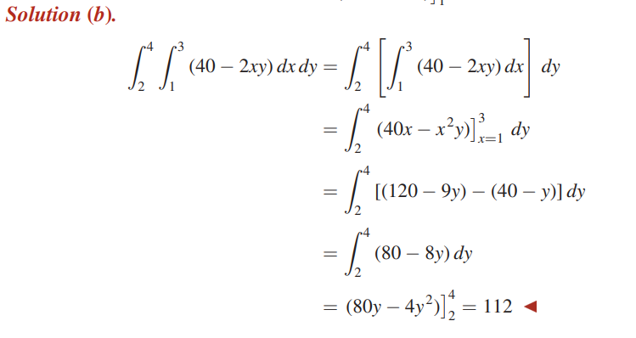

Slide 11
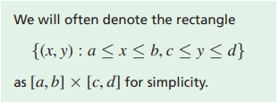
The geometric argument above applies to any continuous function f(x, y) that is nonnegative on a rectangle R = [a, b] × [c, d], as is the case for f(x, y) = 40 − 2xy on [1, 3] × [2, 4].

Slide 12


Slide 13
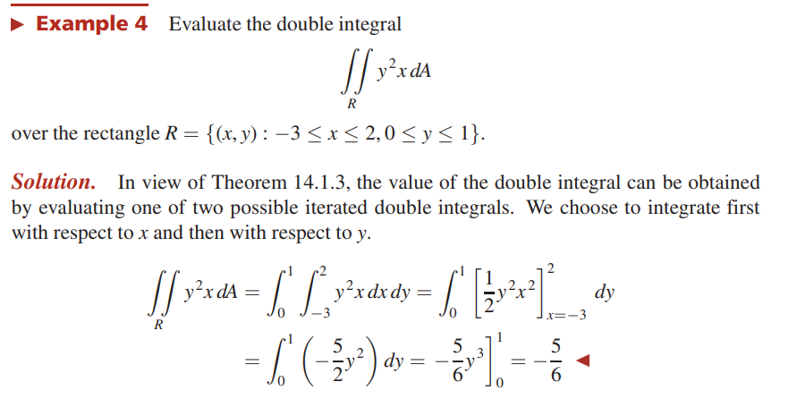

Slide 14
